Slide 1
Signboard Detection
Group no: 01
Group Members:
Homairah Ferdousia(24141198)
Ramisa Sharar Nidhi(24141199)
Rejwan Shafi (23241108)
Anurag Sikder (21301326)

Slide 2
YOLOv8
Newest state of the YOLO model .
Used for object detection,image classification,instance segmentation tasks.
Developed by Ultralytics.
It includes numerous architecture and developer experience changes.

Slide 3
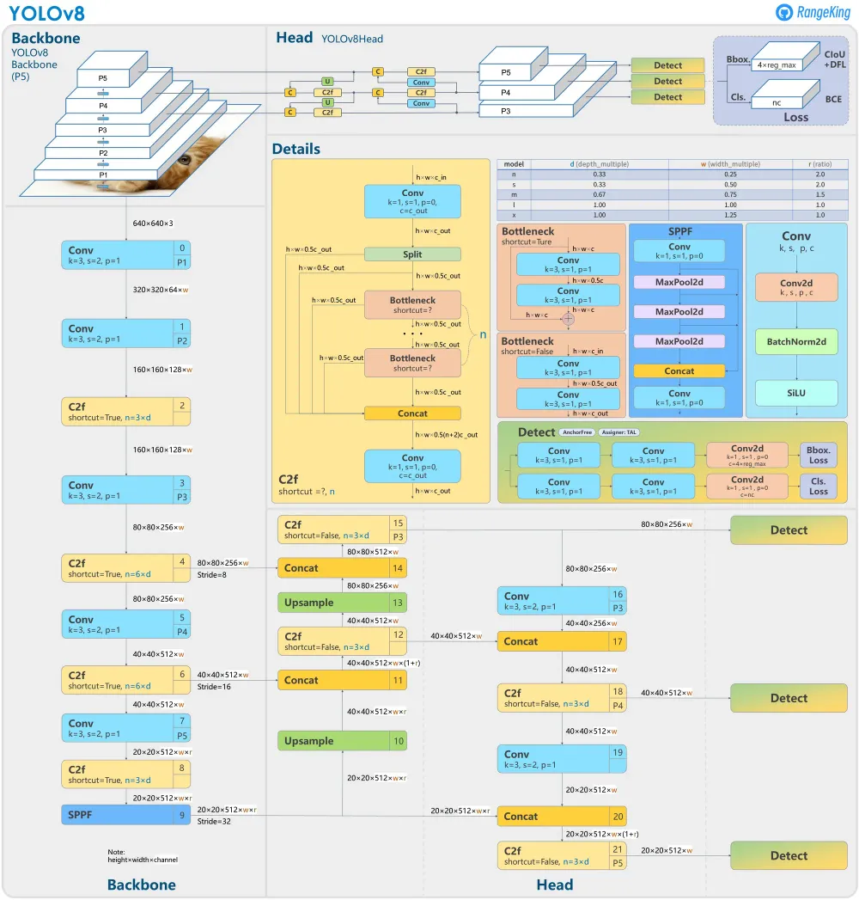
Components:
Backbone
Head
Loss

Slide 4
Backbone:
Input images go through several convolutional layers.
Feature maps correspond to different scale of the input image .
Each path undergoes through convolutional layers with strides and filters reducing the size of the feature map and increasing the depth .

Slide 5
Head:
Responsible for making the final predictions
Processes feature maps through various layers such as concatenation,convolution,detection to predict bounding boxes ,class probabilities ,objectness scores

Slide 6
Loss:
Indicate the types of loss function used for training such as bounding box regression loss,classification loss,intersection over union loss

Slide 7
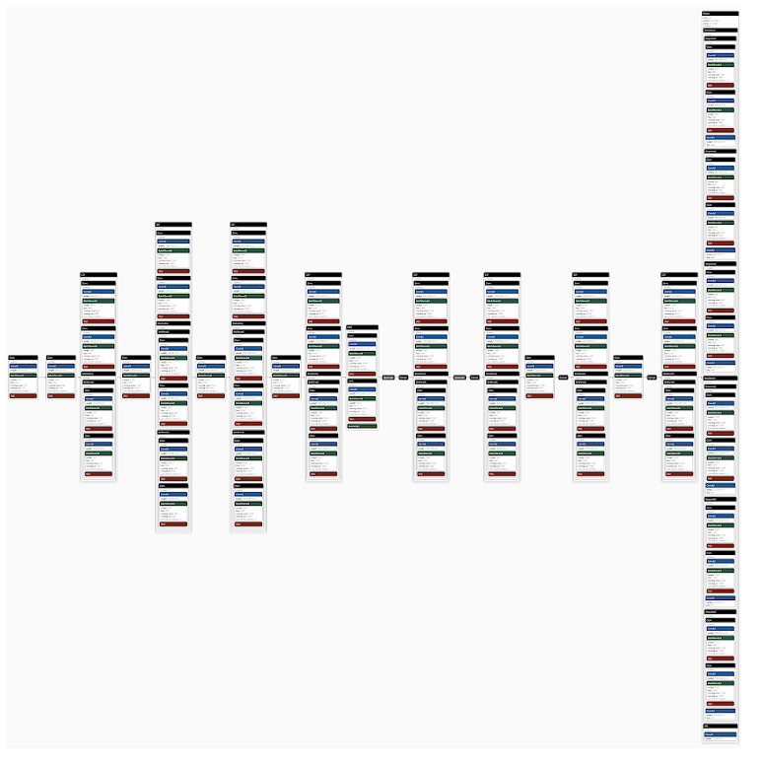
Our Best Model:

Slide 8
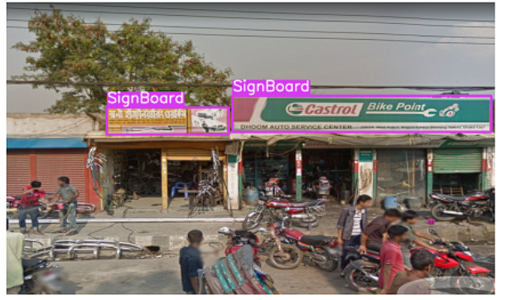
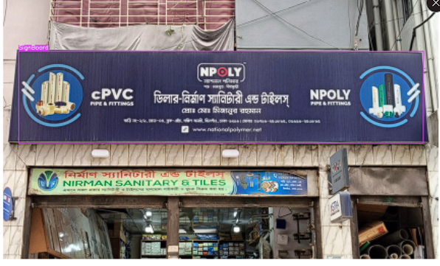
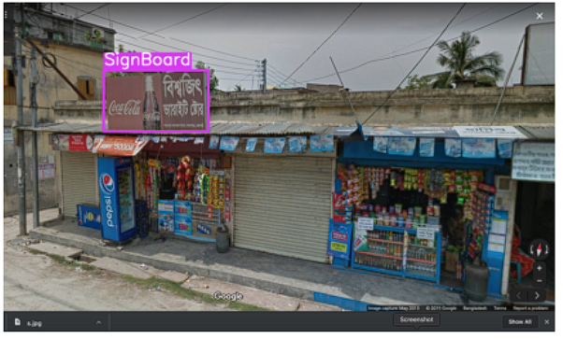
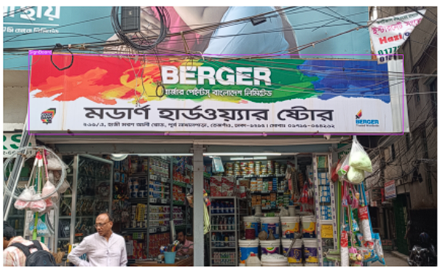
Initial image and label visualization
Good Labeling:

Slide 9
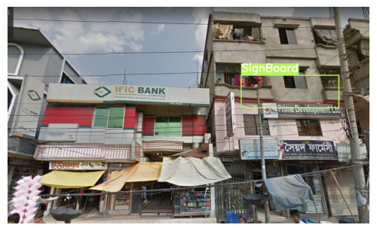
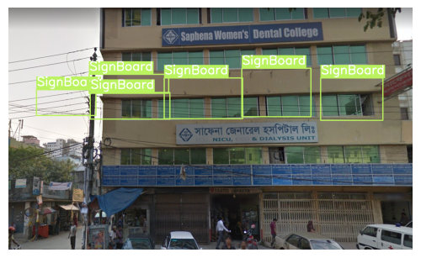
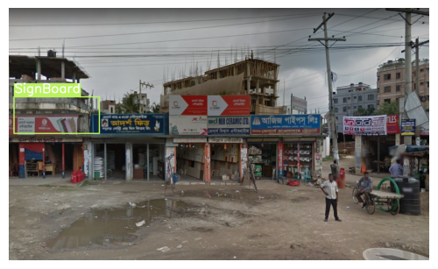
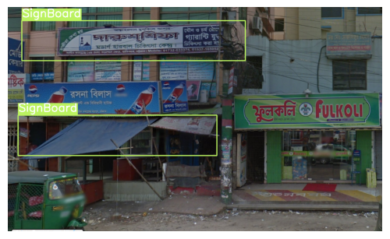
Initial image and label visualization
Bad Labeling:

Slide 10
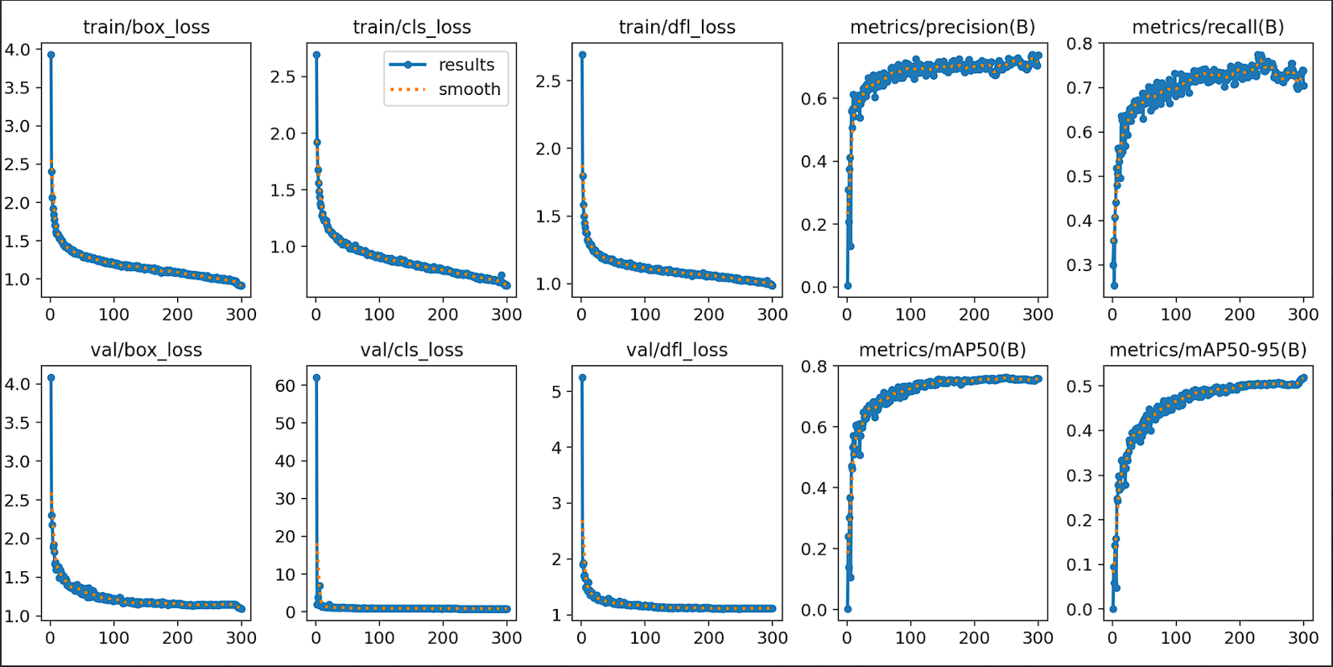
Validation Graphs (Training Phase):

Slide 11
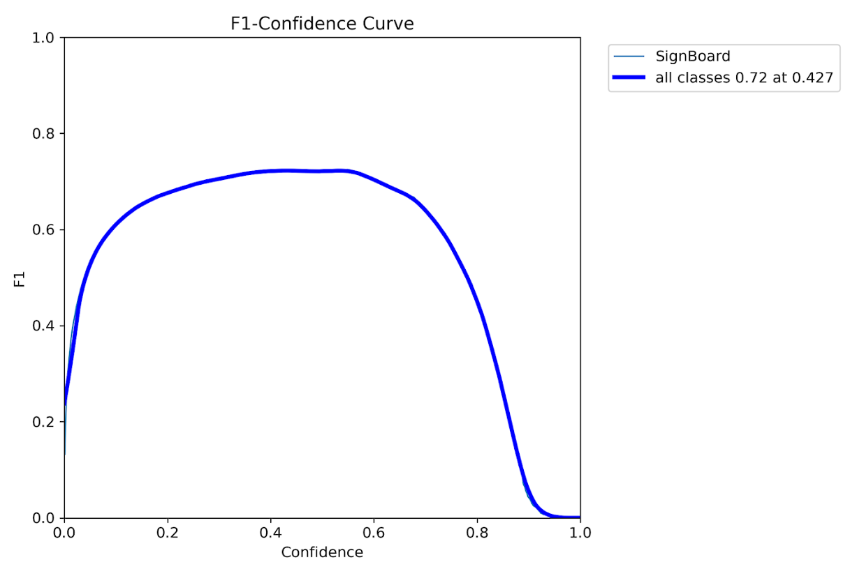
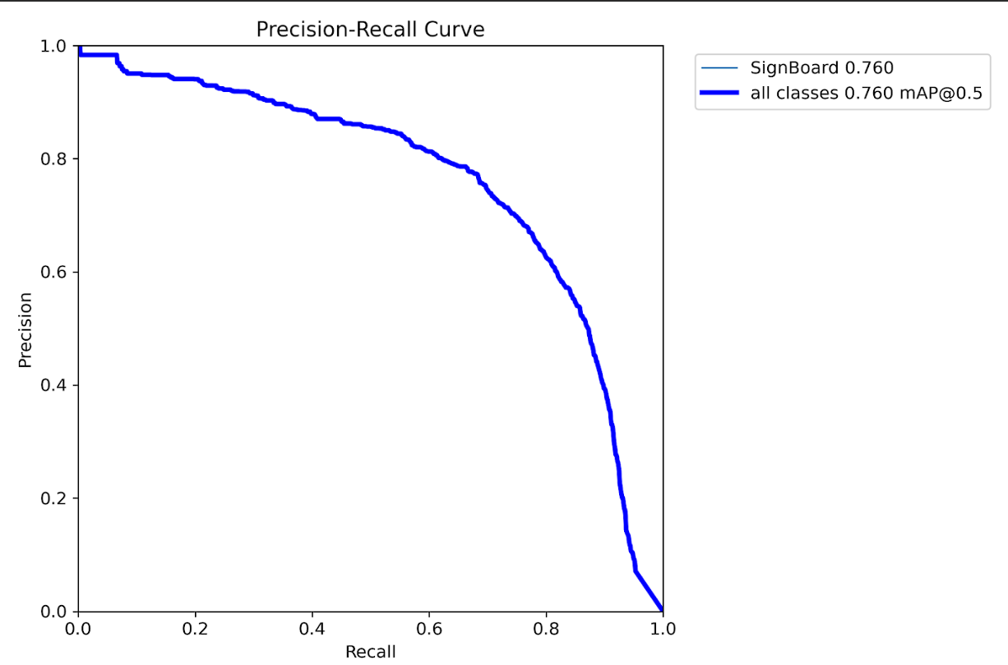
Validation Graphs (Training Phase):

Slide 12
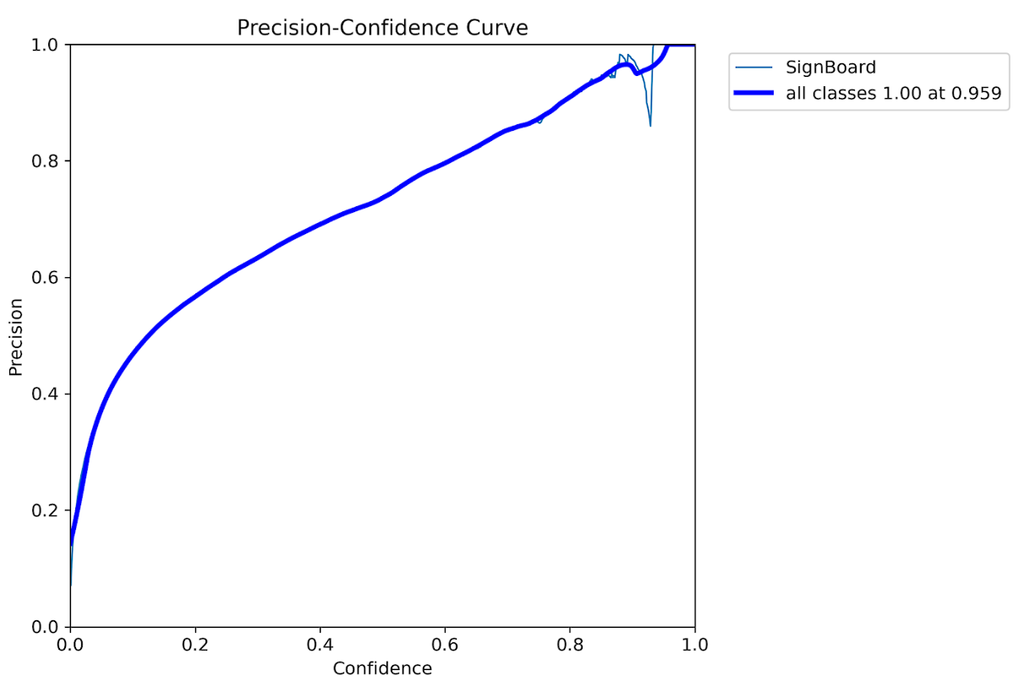
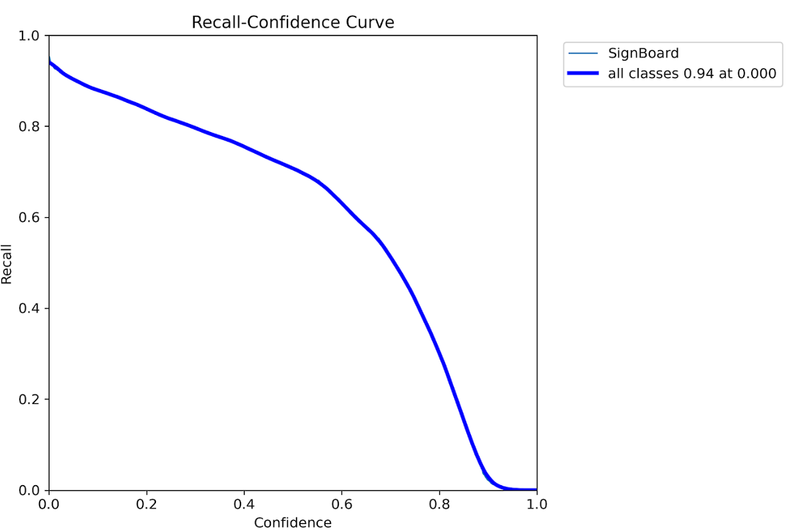
Validation Graphs (Training Phase):

Slide 13
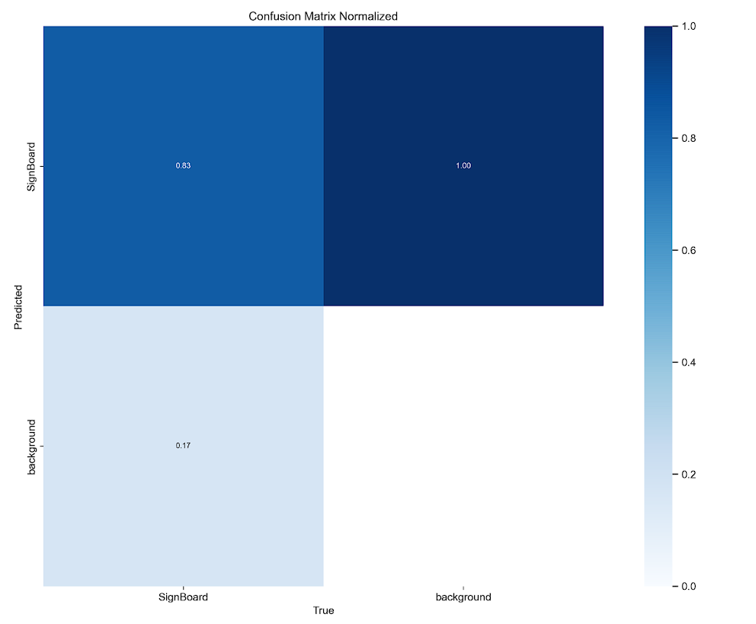
Validation Graphs (Training Phase):

Slide 14
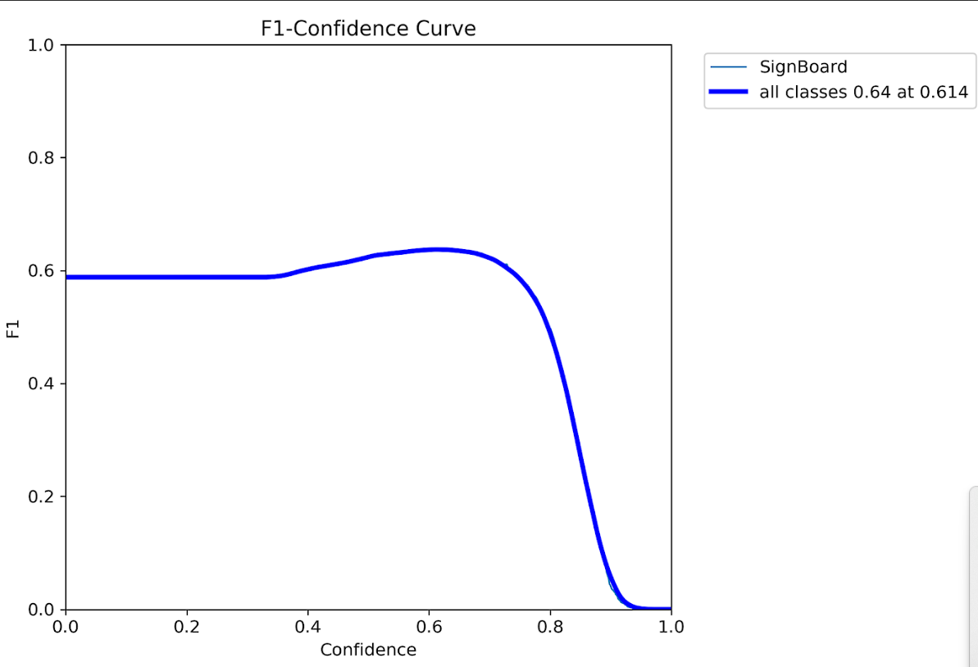
Validation Graphs (Validation Phase):
For validation our image size =544, batch=1, conf=0.35 and IoU= 0.5

Slide 15
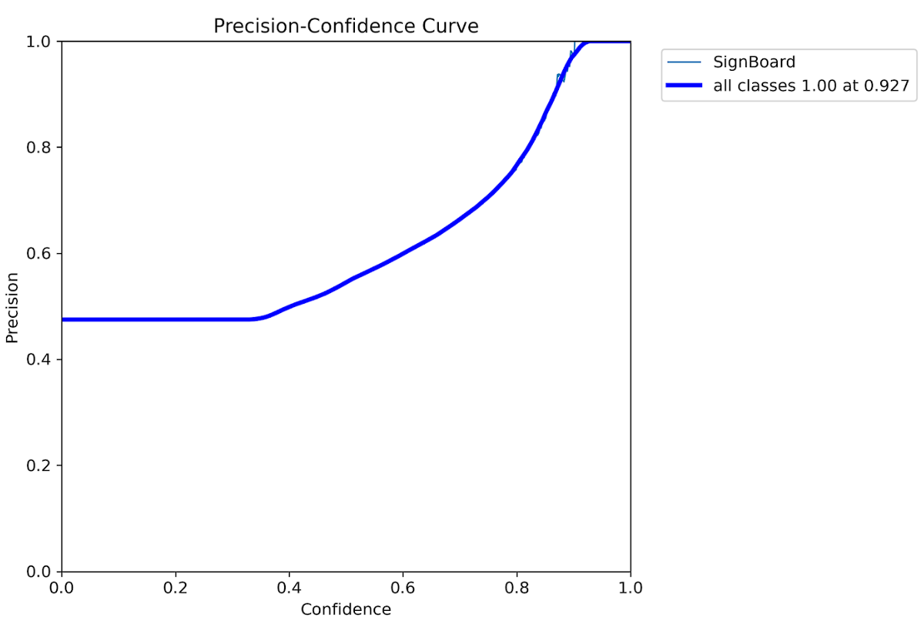
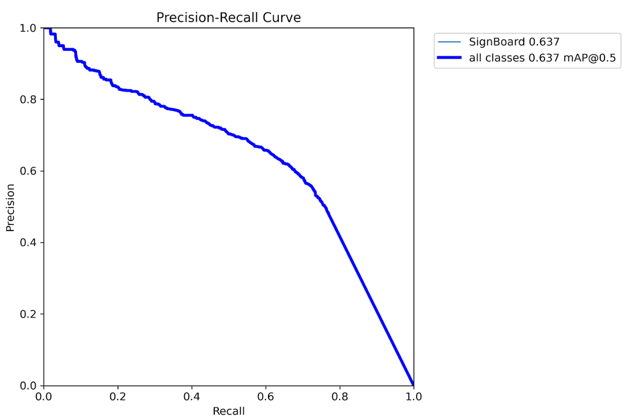
Validation Graphs (Validation Phase):

Slide 16
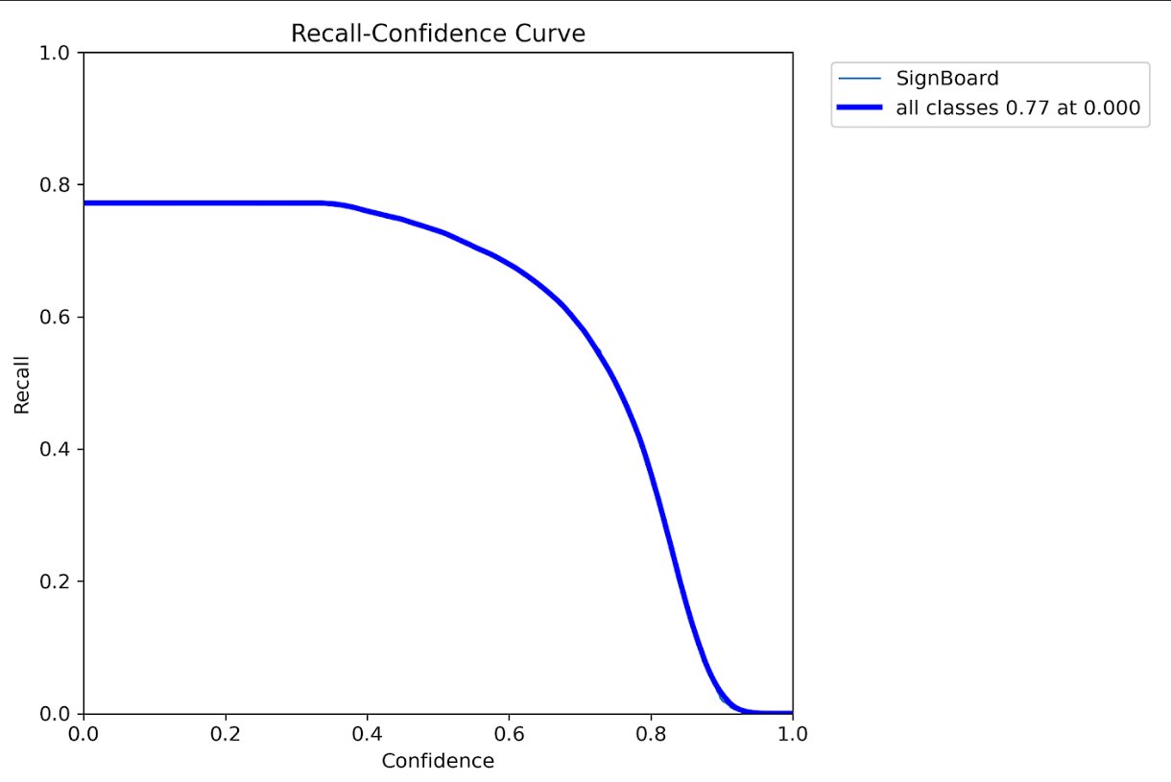
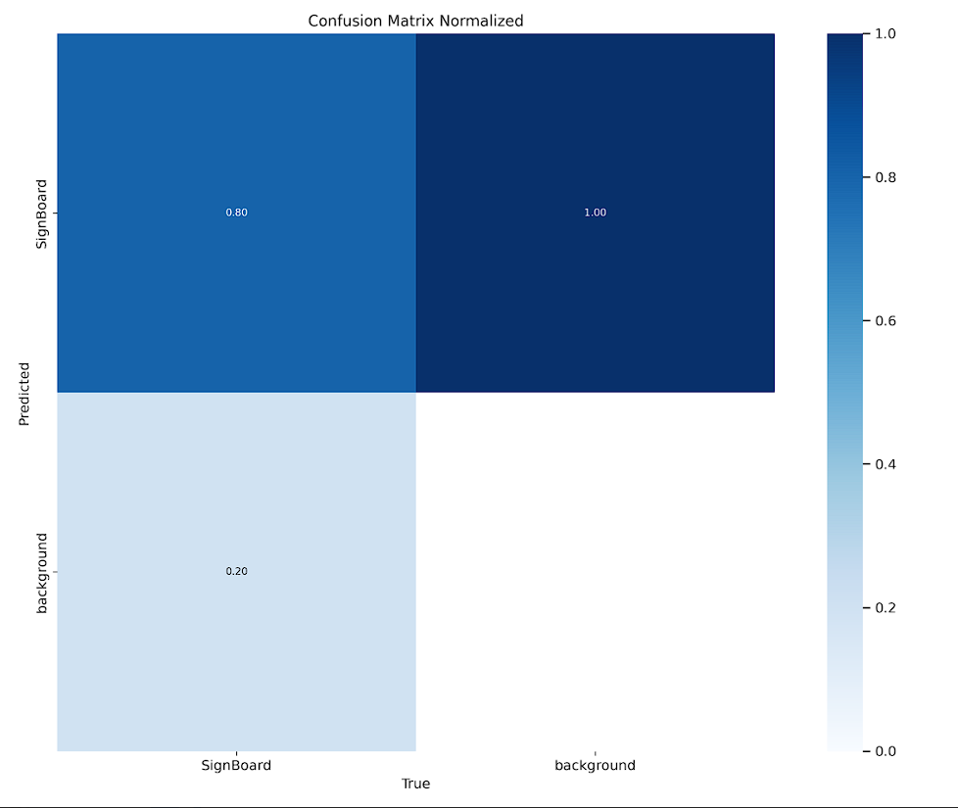
Validation Graphs (Validation Phase):

Slide 17
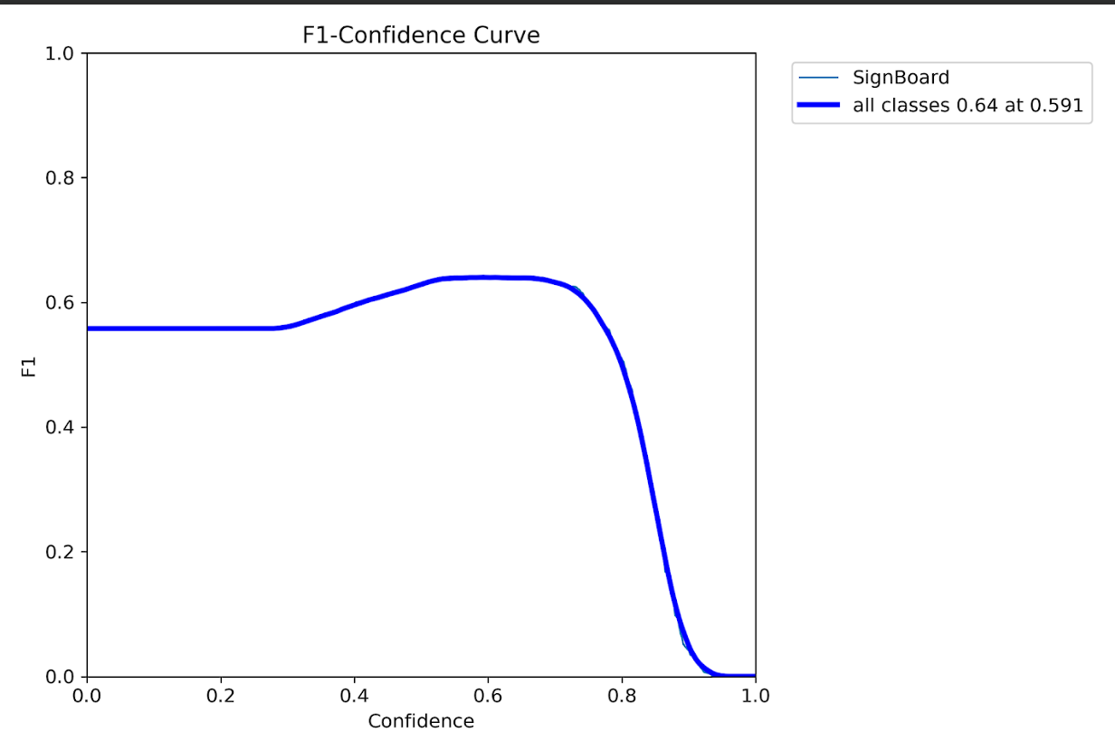
Validation Graphs (Testing Phase):
For validation on our testing images, image size =576, batch=1, conf=0.3 and IoU= 0.5

Slide 18
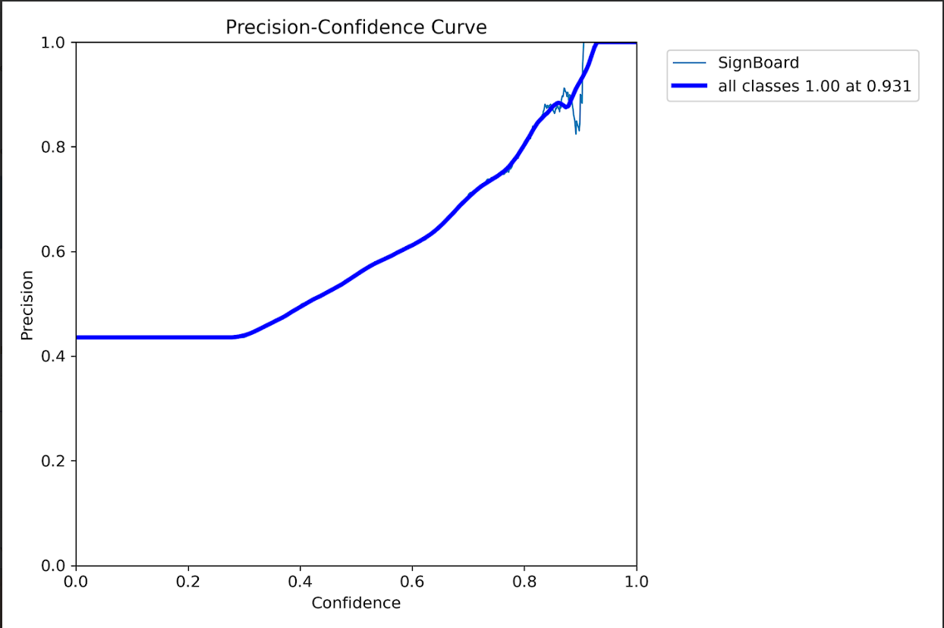
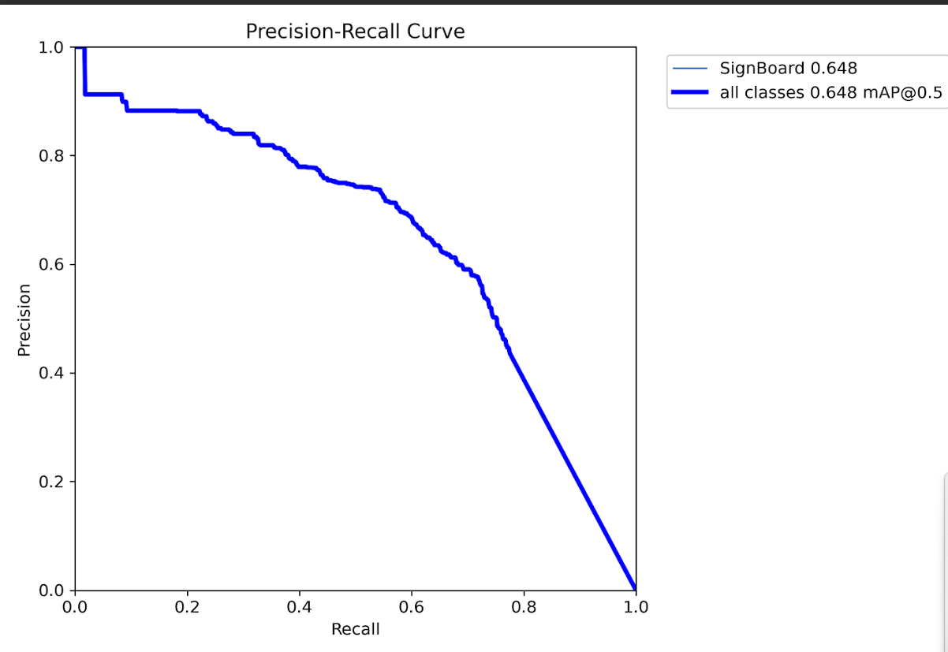
Validation Graphs (Testing Phase):

Slide 19
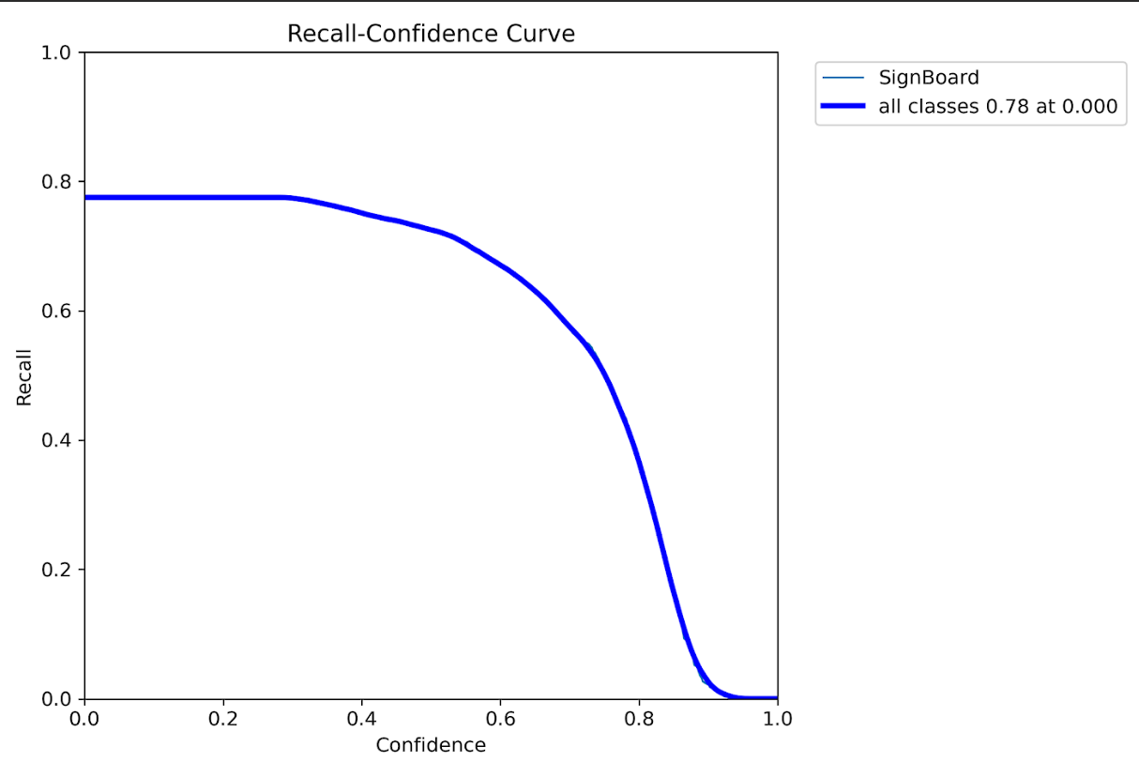
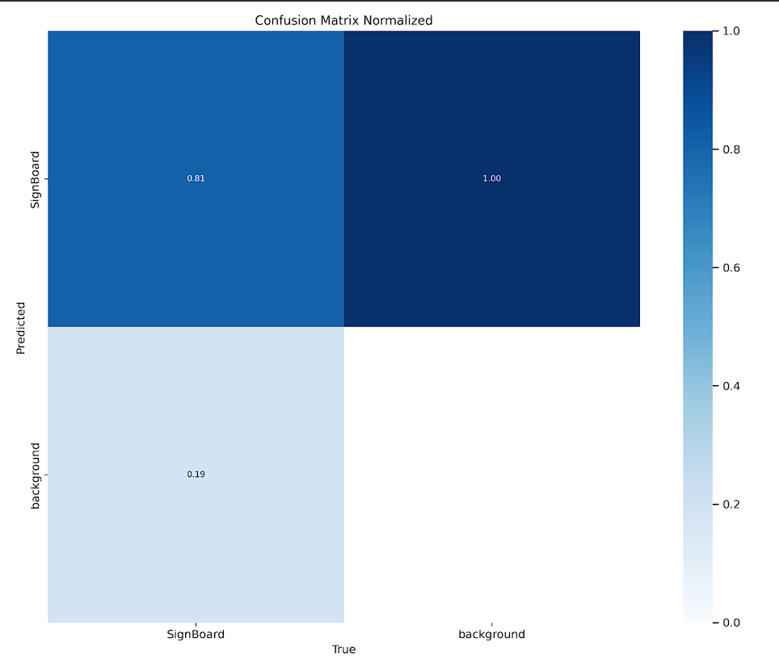
Validation Graphs (Testing Phase):

Slide 20
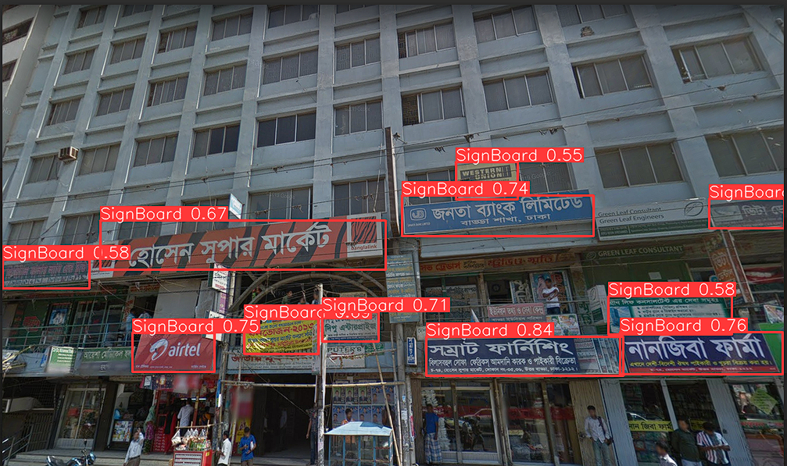
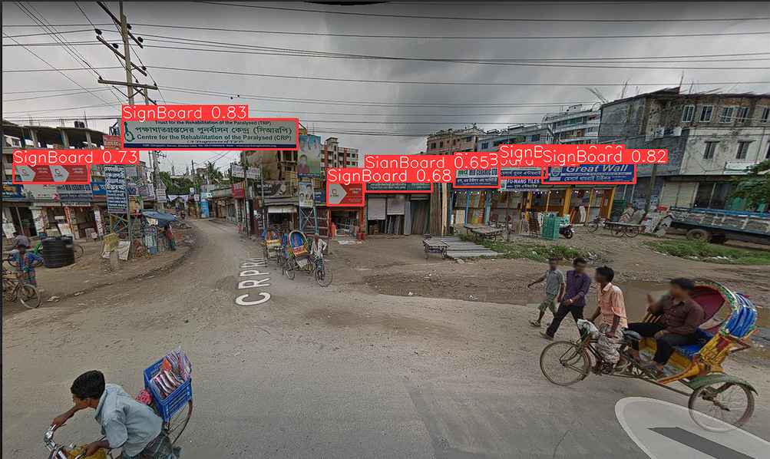
Good Examples on Predicted Images

Slide 21
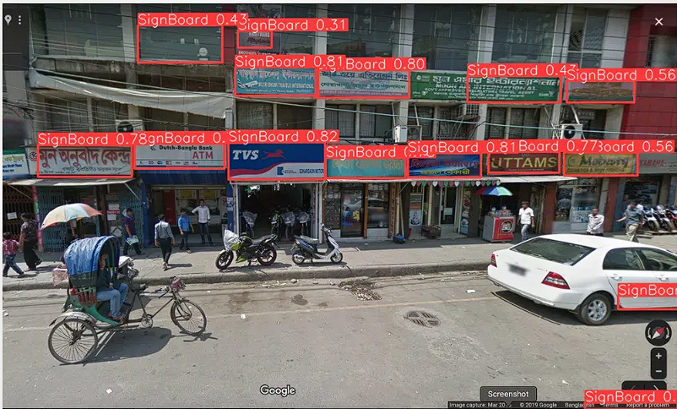
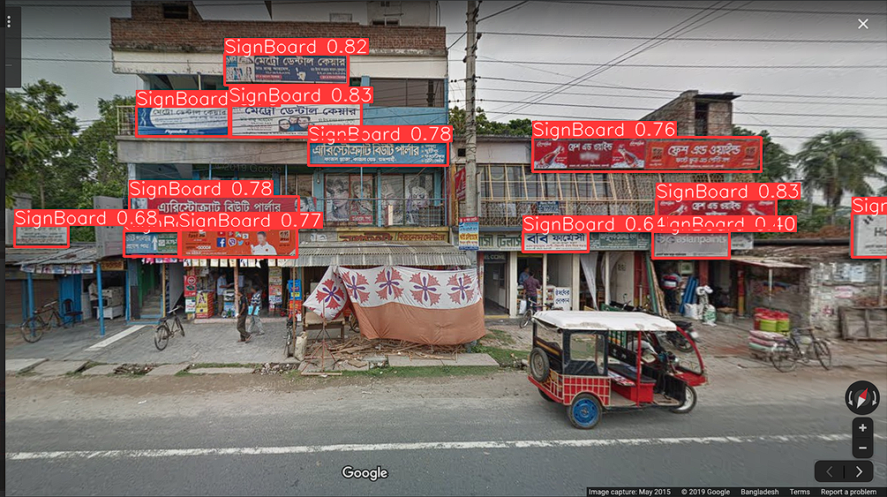
Good Examples on Predicted Images

Slide 22
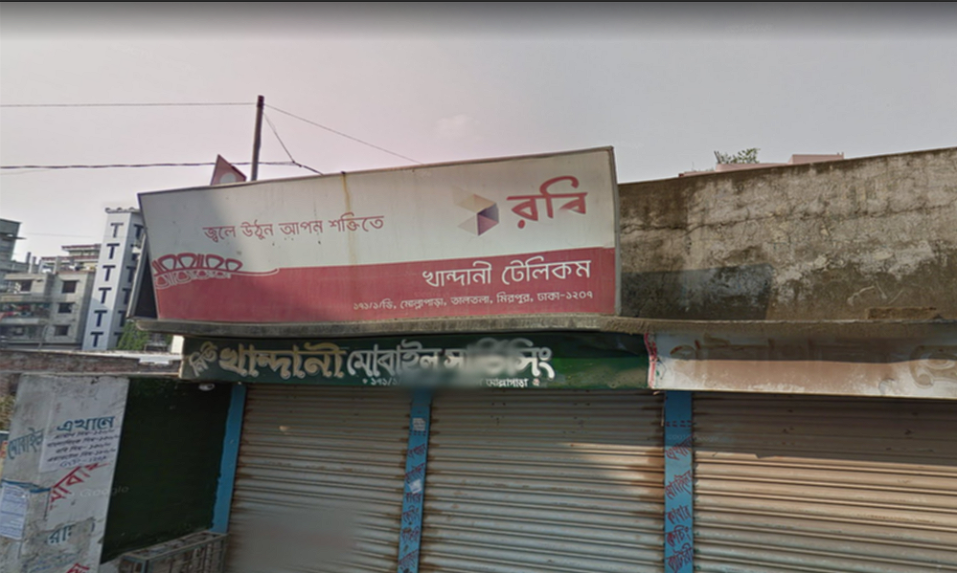
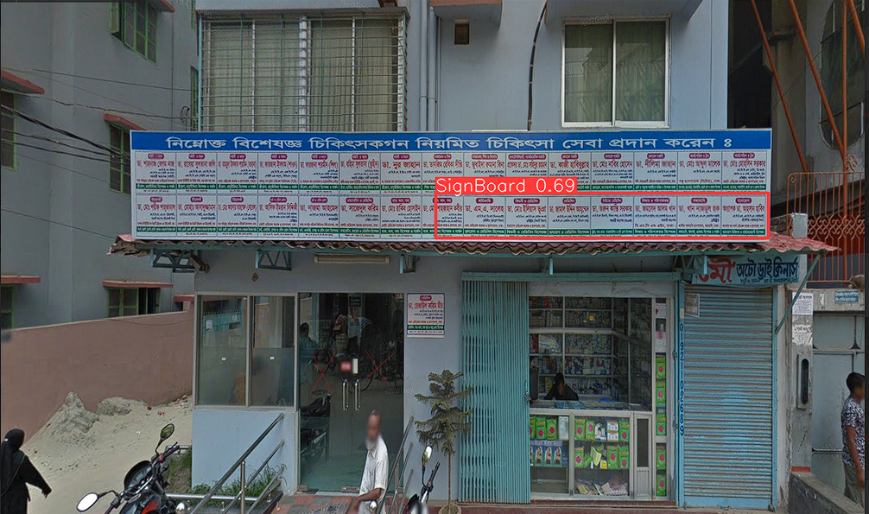
Bad Examples on Predicted Images

Slide 23
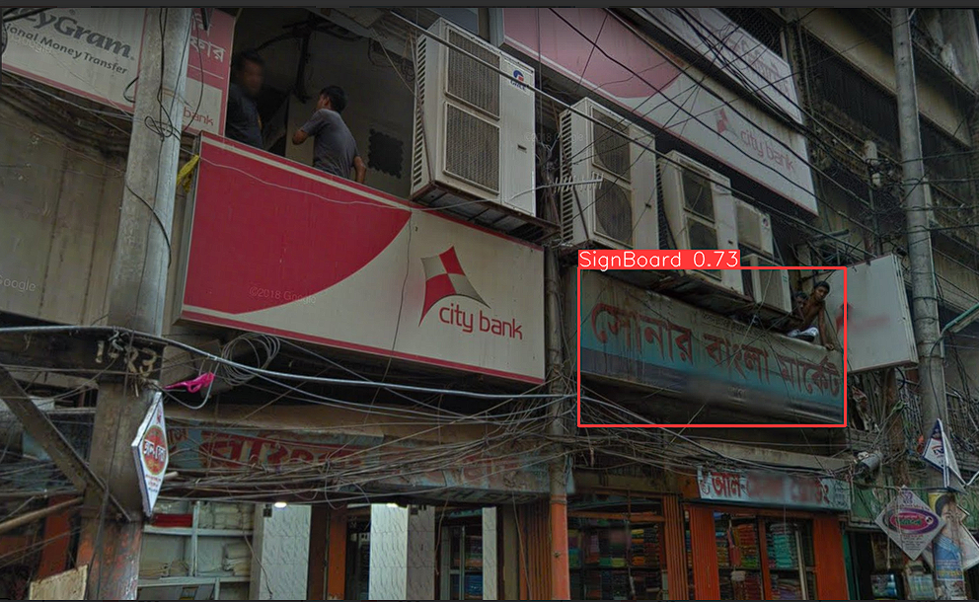
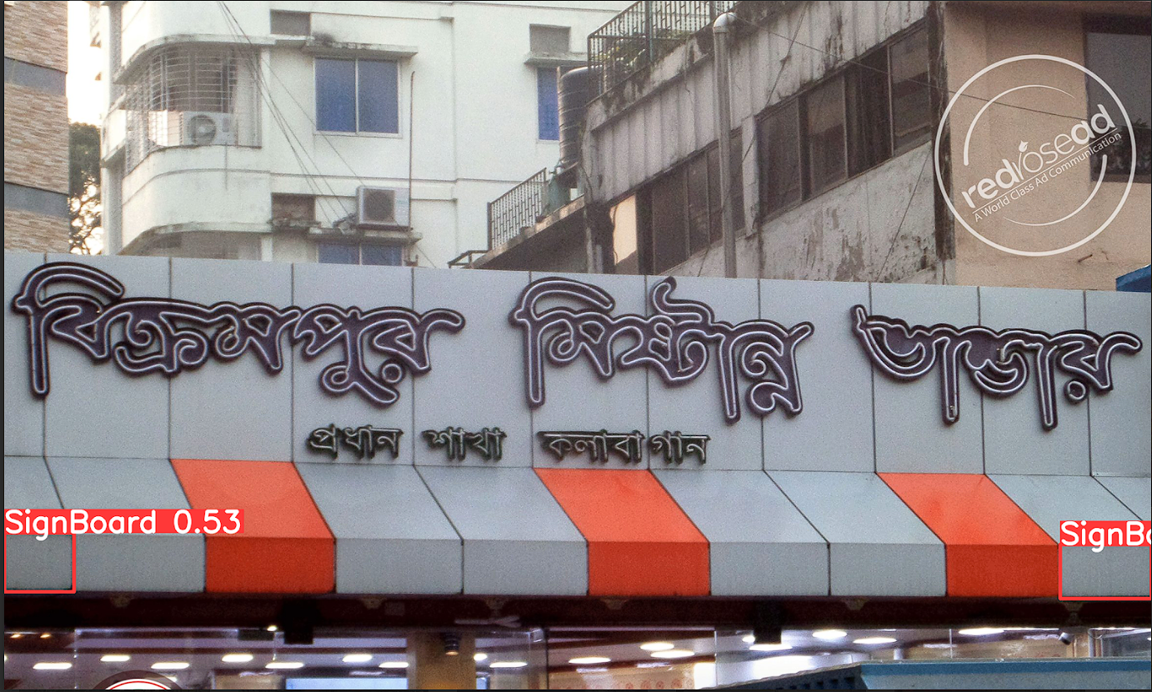
Bad Examples on Predicted Images

Slide 24
Contribution
Initial Image Visualization, Training, IoU Calculation (Validation Set) | Rejwan Shafi (23241108)
Prediction, IoU Calculation (Prediction Set) | Anurag Sikder (21301326)
Validations | Homairah Ferdousia(24141198)
Figures | Ramisa Sharar Nidhi(24141199)

Slide 25
Thank you

